Slide 1


Flex-Fuel Vehicles (FFV) Fuel Economy, Annual Fuel Cost, Emissions, and Consumer’s Best Choice
Analysis and Presentation:
William Molina

Slide 2
Overview:
FFV Definition
Gasoline vs E85 fuel
Fuel Economy
Annual Cost
Emissions
Vehicle Recommendations

Slide 3



What is a Flexible-Fuel Vehicle (FFV)?

Slide 4


Gasoline VS Ethanol
Gasoline
typically E10 (10% ethanol, 90% gasoline)
Gasoline – non-renewable fossil fuel
E 85 (ethanol blend)
ethanol fuel blend of 85% ethanol and 15% gasoline or other hydrocarbon by volume
Ethanol – type of alcohol, plant based renewable fuel

Slide 5
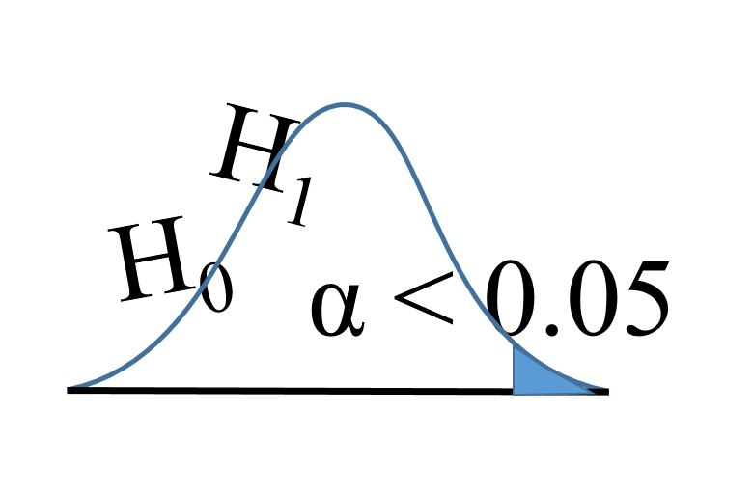
HYPOTHESES
H1
Is there a statistical difference in mean MPG when FFV vehicles use either regular gasoline or E85 fuel?
(Null Hypotheses)
Ho: μ1 - μ2 = 0 : There is no statistical difference in mean MPG between gasoline & E85 fuel
H2
Is there a statistical difference in mean annual fuel cost for FFV vehicles when using either regular gas or E85 fuel?
(Null Hypotheses)
Ho: μ1 - μ2 = 0 : There is no statistical difference in mean annual fuel cost between gasoline & E85
H3
Is there a statistical difference in mean CO2 emissions from FFV vehicles that use either regular gas or E85 fuel?
(Null Hypotheses)
Ho: μ1 - μ2 = 0 : There is no statistical difference in mean emissions between gasoline & E85
This Photo by Unknown Author is licensed under CC BY

Slide 6


Data Source
Kaggle
EPA data, 1984-2017
“All estimates based on laboratory testing under standardized conditions to allow for fair comparison”.

Slide 7
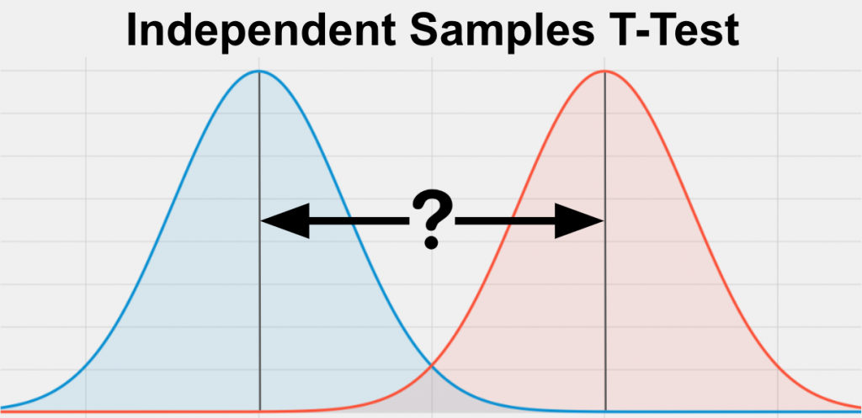
Methods
Independent Samples t-test
The Independent Samples t Test compares the means of two independent groups in order to determine whether there is statistical evidence that the associated population means are significantly different
What does is tell us?
Is there a statistical difference between the averages of gasoline and E85?
And If there is, what is it?

Slide 8

1. Fuel Economy Average MPG
Combined MPG 55% City/45% Highway
Regular Gasoline VS E 85 Fuel

Slide 9
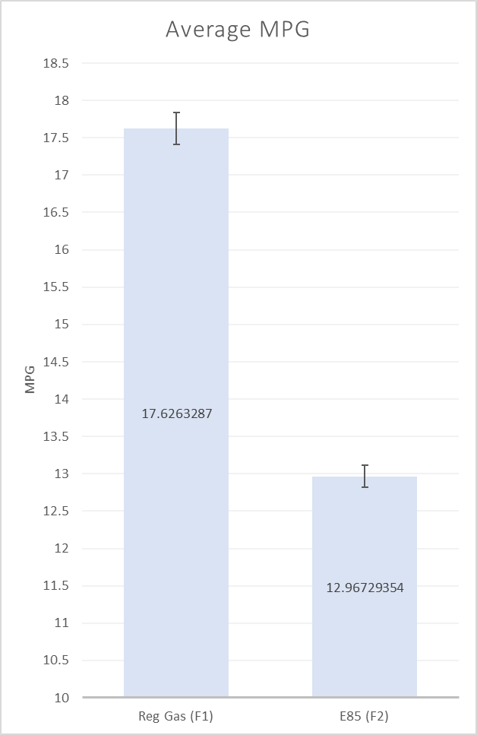
Is there a statistical difference in mean MPG when FFV vehicles use either regular gasoline or E85 fuel?
RESULTS
Difference is significant: p value 2.3235E-213 < 5%
Ho: μ1 - μ2 = 0 (Reject Null Hypotheses)
Ha: μ1 - μ2 ≠ 0
Reject null hypothesis that there is no difference between combined MPG for gasoline and Ethanol E 85
Mean difference: 4.66 MPG
With 95% confidence, c.i. 4.40 – 4.92 MPG
Cohen's d = 1.42 (large effective size)

Slide 10
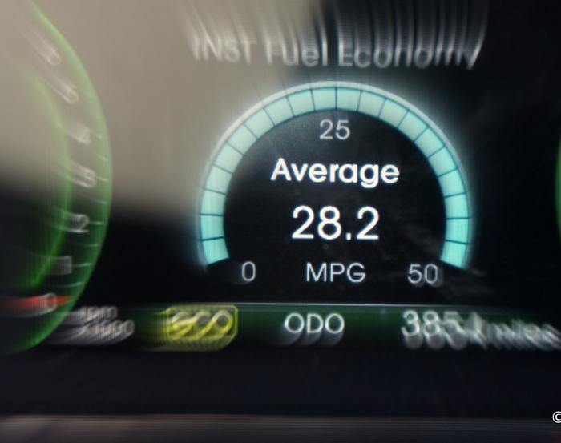
On average, gasoline is 30.5% more efficient than E85 fuel
This Photo by Unknown Author is licensed under CC BY

Slide 11

2. Average Annual Fuel Cost
Annual fuel cost is based on 15,000 miles, 55% city driving 45% highway
Fuel prices for E85 are from the Office of Energy Efficiency and Renewable Energy's Alternative Fuel Price Report
Fuel prices for gasoline from the Energy Information Administration
Regular Gasoline VS E 85 Fuel
This Photo by Unknown Author is licensed under CC BY-SA

Slide 12
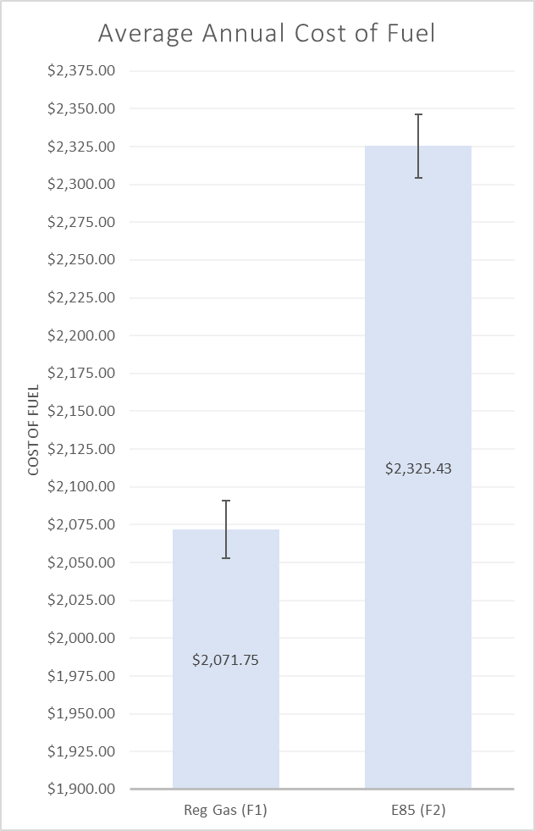
Is there a statistical difference in mean annual fuel cost for FFV vehicles when using either regular gas or E85 fuel?
RESULTS
Difference is significant: P value 5.60718E-47 < 5%
Ho: μ1 - μ2 = 0 (Reject Null Hypotheses)
Ha: μ1 - μ2 ≠ 0
Reject null hypothesis that there is no difference between fuel cost for Gasoline and E 85
Mean difference: $254
With 95% confidence, c. i.: $225-$282
Cohen's d = 0.5 (medium effective size)

Slide 13

On average, gasoline is 22.5% less expensive

Slide 14

3. Average Fuel Emissions
CO2 Grams/Mile
Emissions Comparison
Regular Gasoline VS E 85 Fuel

Slide 15
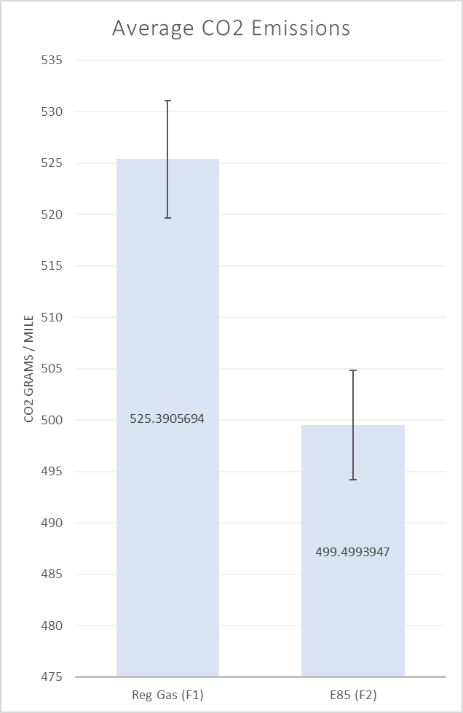
Is there a statistical difference in mean CO2 emissions from FFV vehicles that use either regular gas or E85 fuel?
RESULTS
Difference is significant: P value 5.60718E-47 < 5%
Ho: μ1 - μ2 = 0 (Reject Null Hypotheses)
Ha: μ1 - μ2 ≠ 0
Reject null hypothesis that there is no difference between tailpipe emissions measured as CO2 g/mi for Gasoline and E 85
Mean difference: 24.5 g/mi
95% confidence, c.i.: 17.0 - 32.1 g/mi
Cohen's d = 0.25 (small effective size)

Slide 16

On average, E85 produces 5.1% less in CO2 emissions
This Photo by Unknown Author is licensed under CC BY

Slide 17

Conclusion
Gasoline VS E 85 Fuel
Fuel Economy
Annual Fuel Costs
Emissions

Slide 18
Fuel Economy: More MPG with Gasoline
For max fuel economy chose Gasoline for more MPG for your money
This Photo by Unknown Author is licensed under CC BY-SA

Slide 19
Annual Cost: Gasoline is Cheaper
This Photo by Unknown Author is licensed under CC BY-SA

Slide 20

Emissions: E 85 has lower CO2 emissions than Regular Gasoline
This Photo by Unknown Author is licensed under CC BY-SA

Slide 21

Consumer Best Choice…

Slide 22



Consumer Best Choice: Top 3 Vehicles in each category
1. Ford Focus SFE FWD FFV
2. Dodge Dart
3. Hyundai Aura
MPG
Annual Cost
CO2 Emissions
Gas Avg MPG | E 85 Avg MPG
32.00 | 22.00
Avg Gas MPG | Avg E85 MPG
27.00 | 19.50
Avg Gas MPG | Avg E85 MPG
26.00 | 18.00
Gas Annual Cost | E 85 Annual Cost
$1,100.00 | $1,300.00
Gas Annual Fuel Cost | E85 Annual Fuel Cost
$1,300.00 | $1,475.00
Gas Annual Fuel Cost | E85 Annual Fuel Cost
$1,350.00 | $1,600.00
Gas CO2 | E 85 CO2
277.91 g/mile | 281.30 g/mile
Avg Gas CO2 | Avg E85 CO2
327.00 g/mile | 315.50 g/mile
Avg Gas CO2 | Avg E85 CO2
341.81 g/mile | 344.56 g/mile

Slide 23

Thank You: Q&A
Further Questions?

